Slide 1
Data Quality (Again)
Business Intelligence & Analytics

Slide 2
Data quality consequences
Contradictory reports
Deviating from business plans (budgets)
Leads to misguided decisions
Reports can be dated, inconsistent, and incorrect

Slide 3
Data quality consequences
Contradictory reports
Deviating from business plans (budgets)
Leads to misguided decisions
Reports can be dated, inconsistent, and incorrect
What does that have to do with source systems?

Slide 4
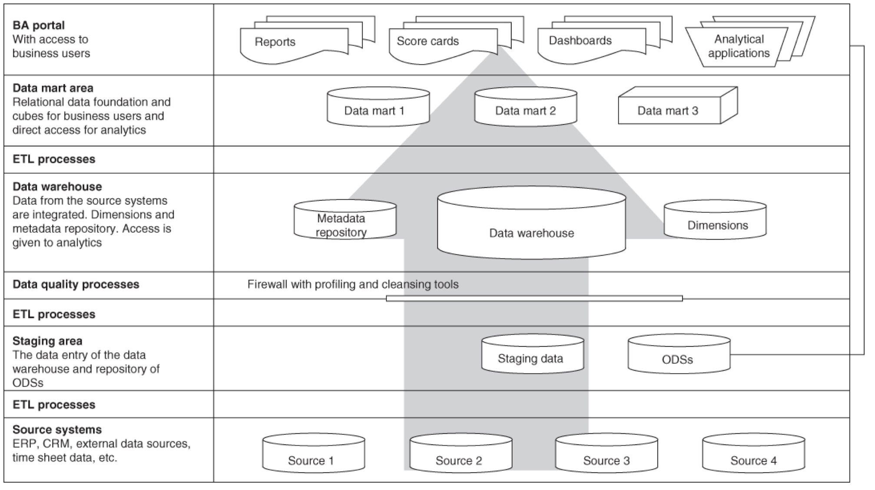

Slide 5
ensuring clean data at the source
Make fields required
Enforce formatting on input
Use drop down lists
Limit raw input to comment fields
Use wizards for object creation
Limit entry of similar data into multiple systems

Slide 6

Data quality at the source system level is important
Several ways to ensure quality data upon input

Slide 7


